Slide 1
ANALYSIS AND INTERPRETATION OF FINANCIAL STATEMENTS

Slide 2
ANALYSIS AND INTERPRETATION OF FINANCIAL STATEMENTS
The term financial statements generally refers to two basic statements : (i) The Income Statement, and (ii) The Balance Sheet.
Financial statements are prepared primarily for decision-making.
They play a dominant role in setting the framework of managerial decisions. But the information provided in the financial statements is not an end in itself as no meaningful conclusions can be drawn from these statements alone.

Slide 3
However, the information provided in the financial statements is of immense use in making decisions through analysis and interpretation of financial statements.

Slide 4
Financial analysis is the process of identifying the financial strengths and weaknesses of the firm by properly establishing relationship between the items of the balance sheet and the profit and loss account.

Slide 5
There are various methods or techniques used in analysing financial statements, such as comparative statements, common-size statements, trend analysis, schedule of changes in working capital, funds flow, cash flow analysis and ratio analysis.

Slide 6
TOOLS OF FINANCIAL ANALYSIS
1. Comparative Financial Statements
2. Common-size Statements
3. Trend Analysis
4. Cash Flow Statement
5. Funds Flow statements
6. Ratio Analysis

Slide 7
1. Comparative Financial Statements
A comparative financial statement is a document used to compare a particular financial statement with prior period statements.
Previous financials are presented alongside the latest figures in side-by-side columns, enabling investors to identify trends, track a company’s progress and compare it with industry rivals
Both the Income Statement and Balance Sheet can be prepared in the form of Comparative Financial Statements.

Slide 8
a) Comparative Income Statement
The comparative Income Statement is the study of the trend of the same items/group of items in two or more Income Statements of the firm for different periods.

Slide 9
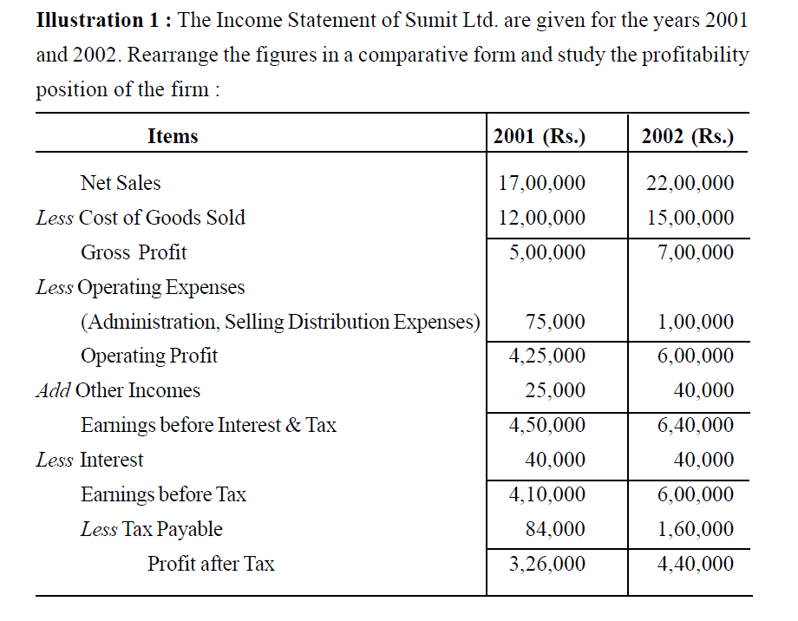

Slide 10
Cost of Goods Sold = Opening Stock + Purchases – Closing Stock

Slide 11
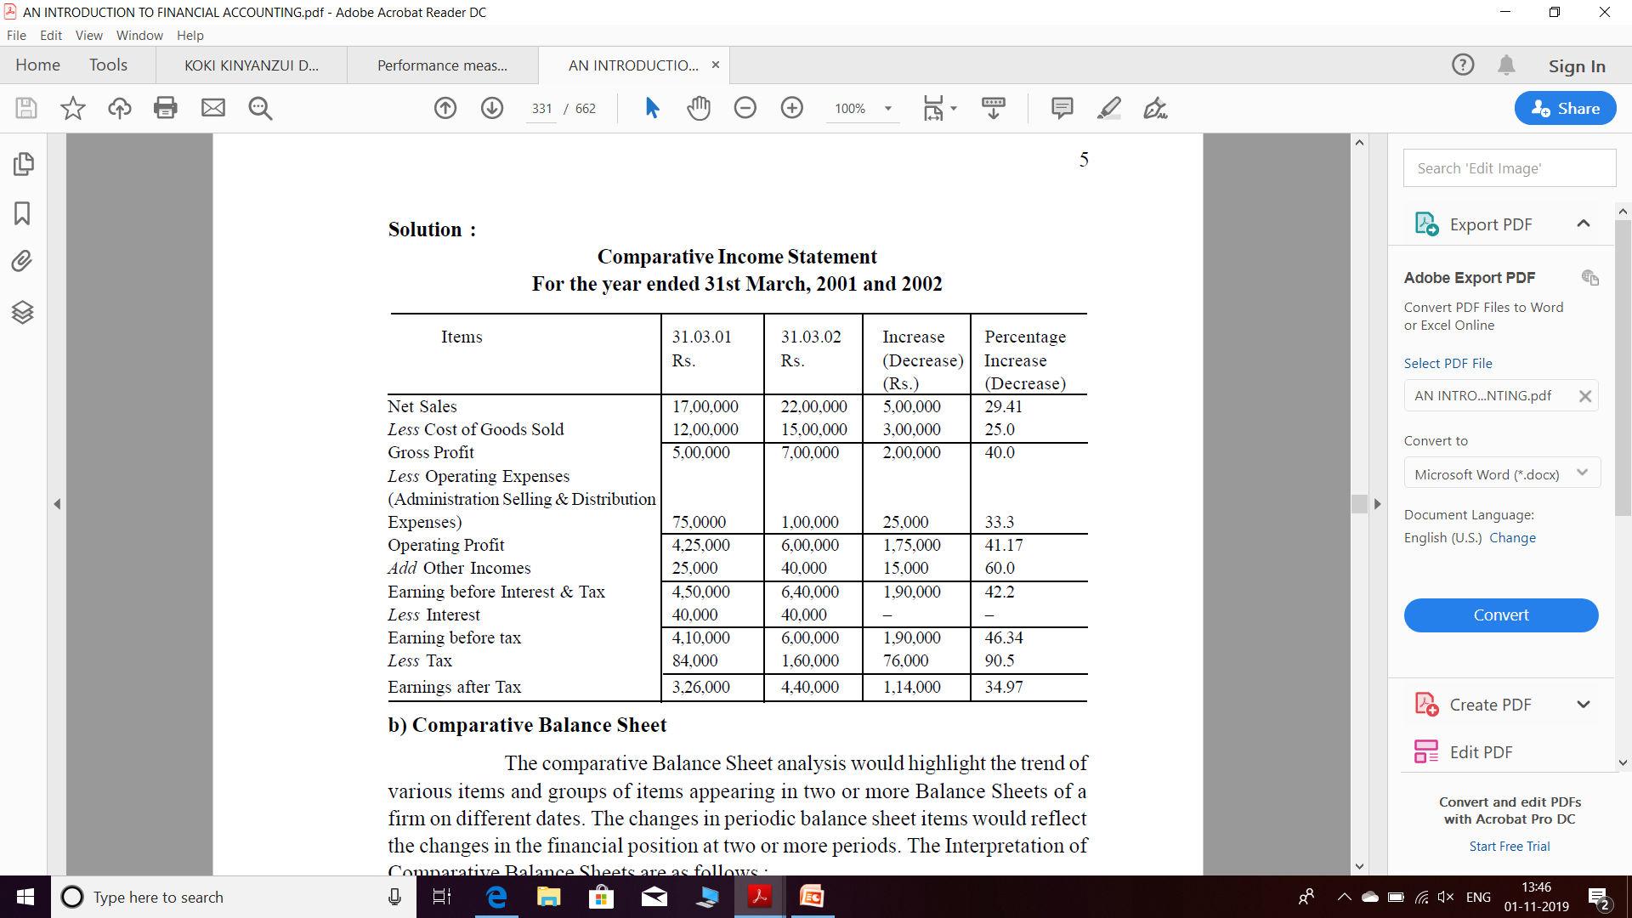

Slide 12
b) Comparative Balance Sheet
The comparative Balance Sheet analysis would highlight the trend of various items and groups of items appearing in two or more Balance Sheets of a firm on different dates.

Slide 13
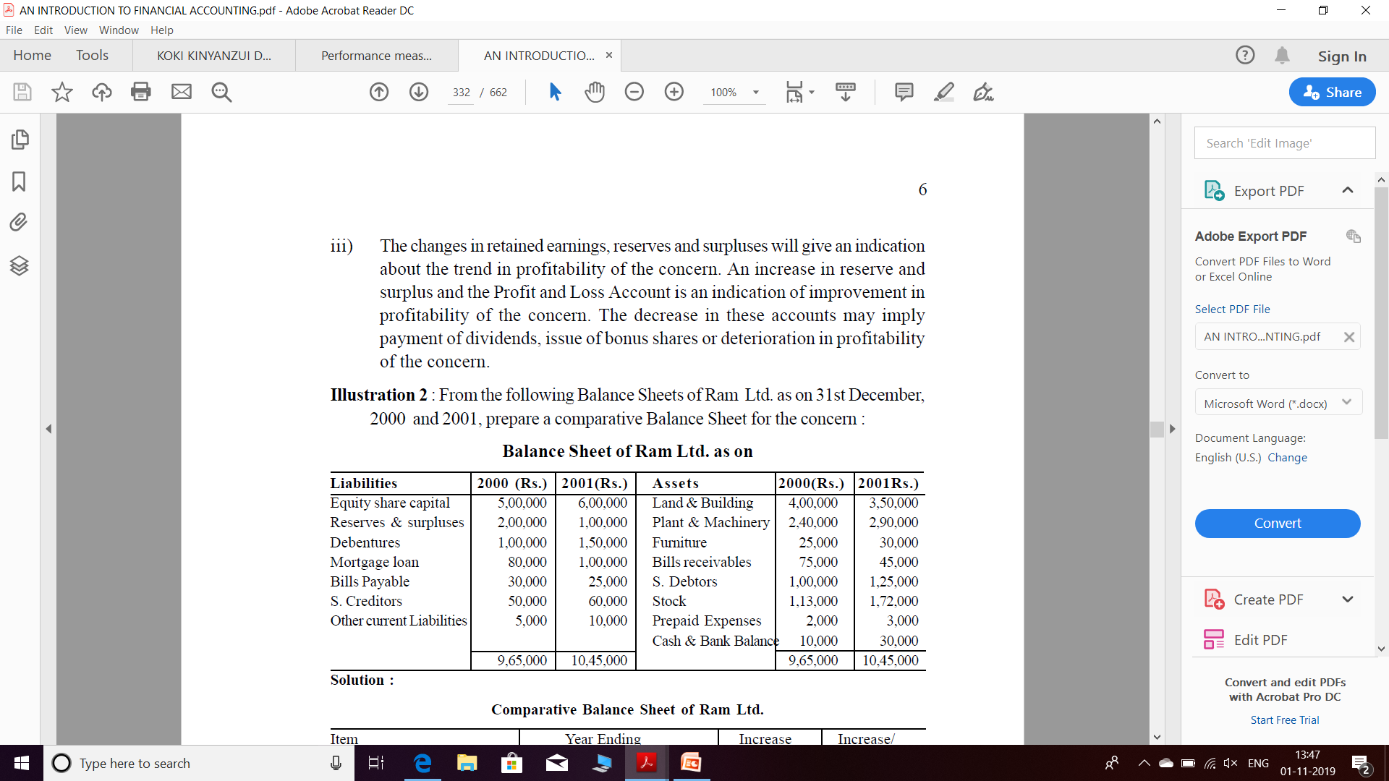

Slide 14
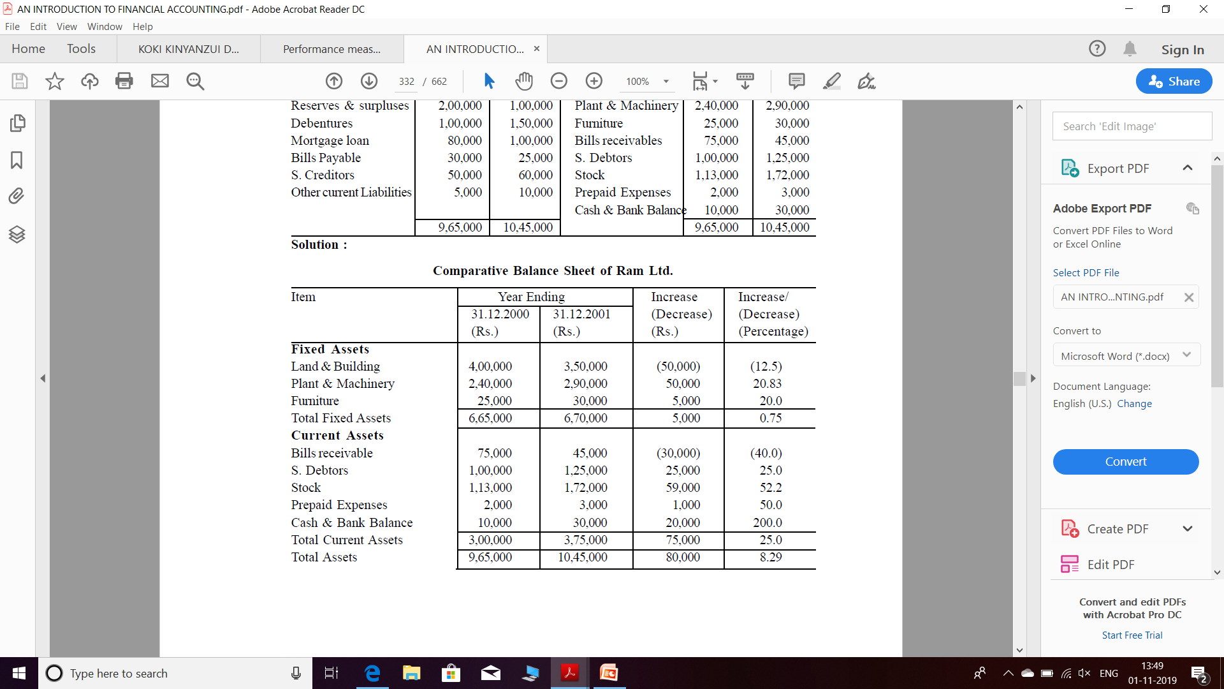

Slide 15
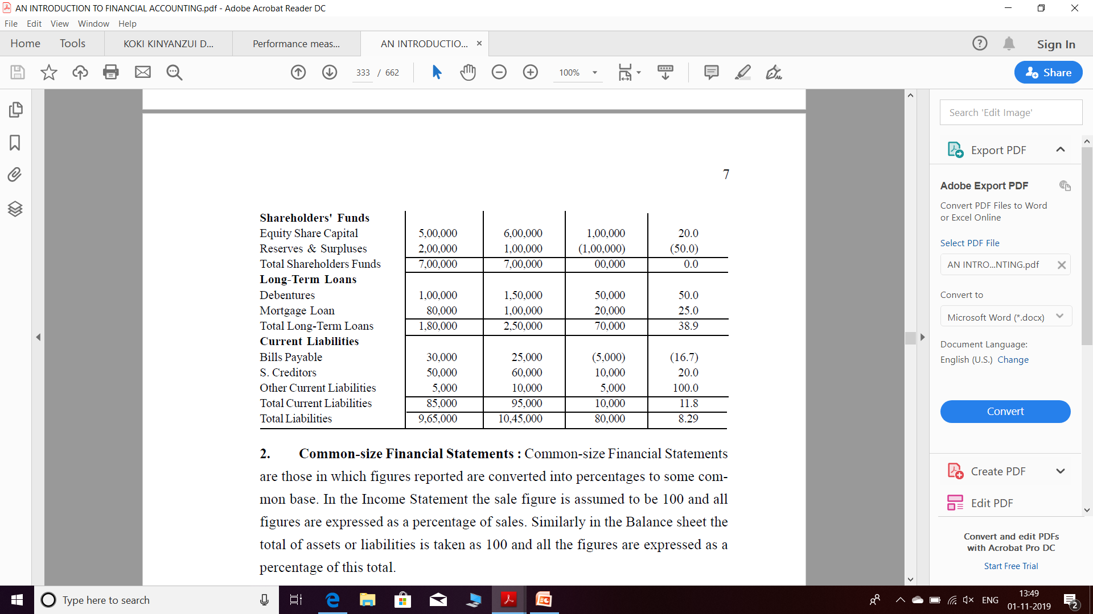

Slide 16
2. Common-size Financial Statements
Common-size Financial Statements are those in which figures reported are converted into percentages to some common base.
In the Income Statement the sale figure is assumed to be 100 and all figures are expressed as a percentage of sales.
Similarly in the Balance sheet the total of assets or liabilities is taken as 100 and all the figures are expressed as a percentage of this total.

Slide 17
a) Common Size Income Statement
In the case of Income Statement, the sales figure is assumed to be equal to 100 and all other figures are expressed as percentage of sales.
The relationship between items of Income Statement and volume of sales is quite significant since it would be helpful in evaluating operational activities of the concern.
The selling expenses will certainly go up with increase in sales. The administrative and financial expenses may go up or may remain at the same level. In case of decline in sale, selling expenses should definitely decrease.

Slide 18
Illustration 3 : From the following Profit and Loss Accounts and the Balance Sheets of Swadeshi Polytex Ltd. for the year ended 31st December 2000 and 2001, you are required to prepare common size statements.

Slide 19
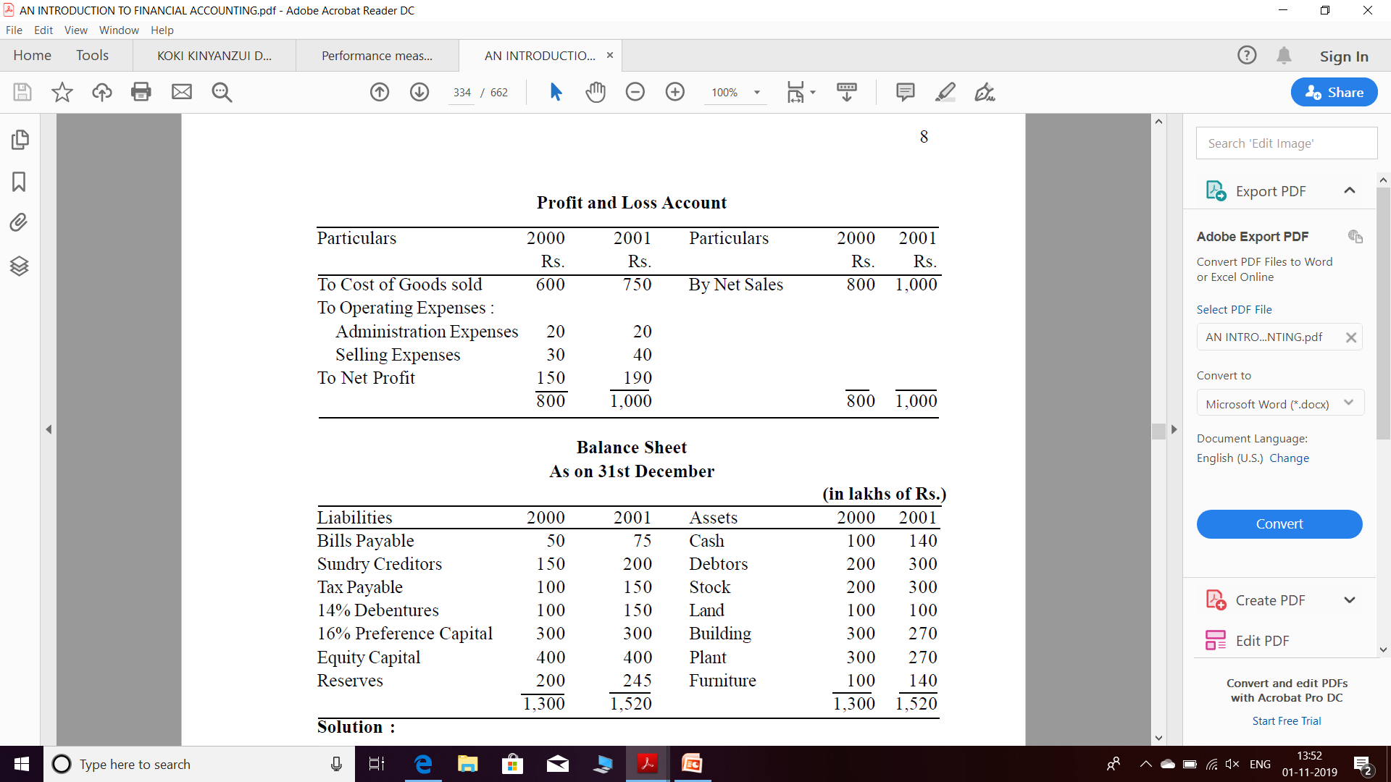

Slide 20
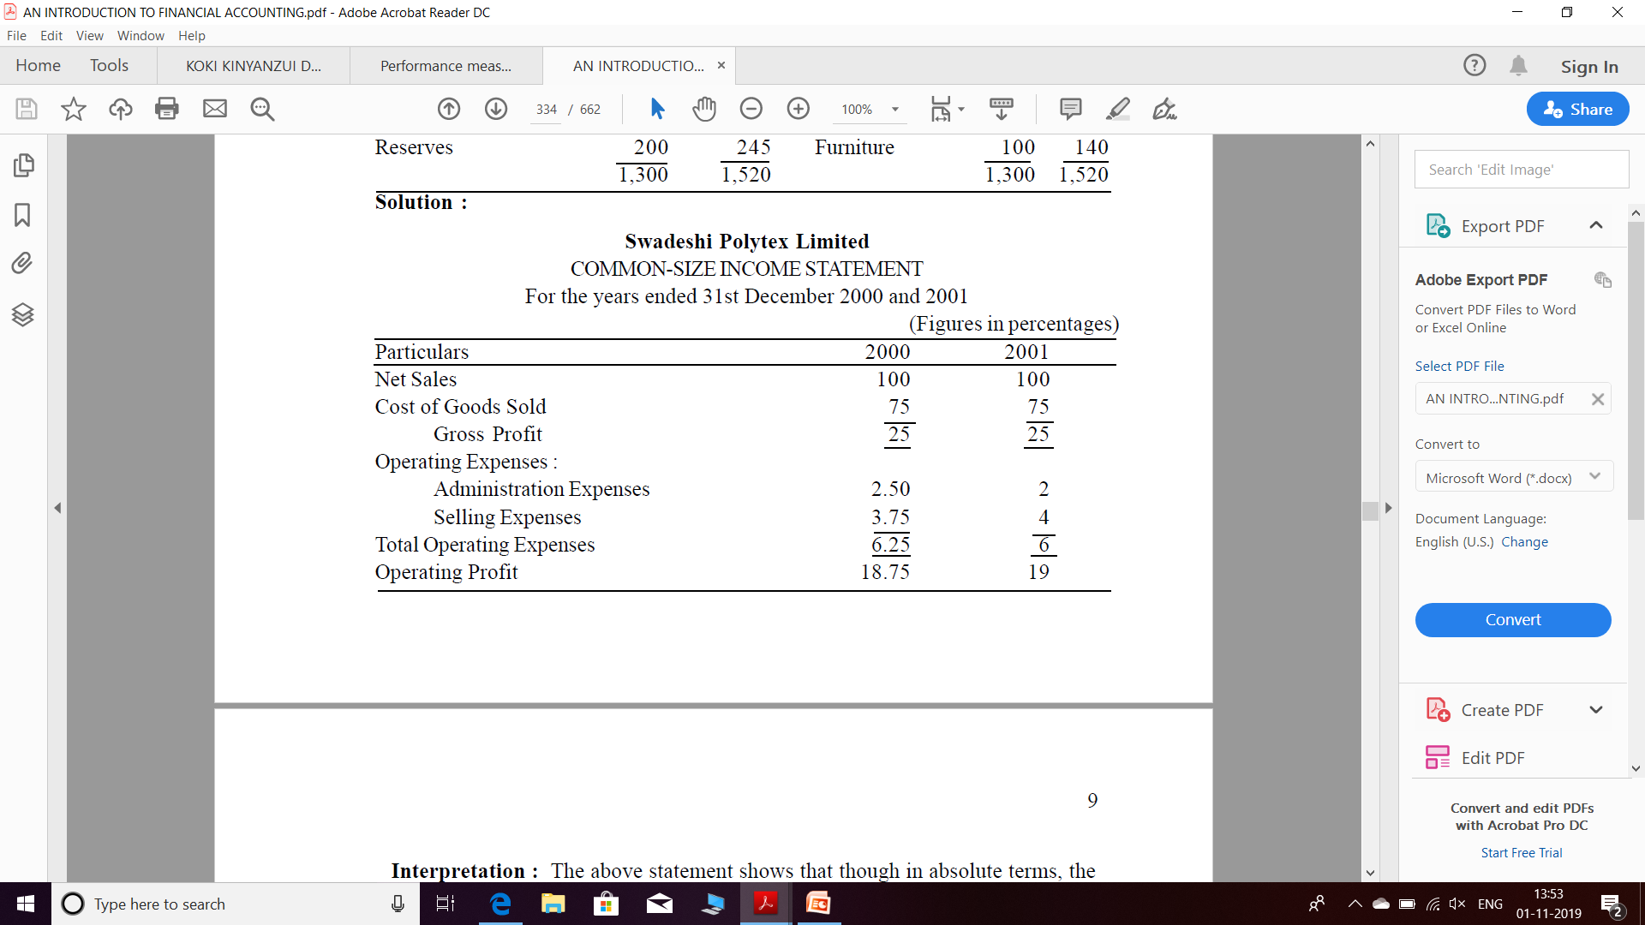

Slide 21
b) Common Size Balance Sheet
For the purpose of common size Balance Sheet, the total of assets or liabilities is taken as 100 and all the figures are expressed as percentage of the total.
In other words, each asset is expressed as percentage to total assets/liabilities and each liability is expressed as percentage to total assets/liabilities.
This statement will throw light on the solvency position of the concern by providing an analysis of pattern of financing both long-term and working capital needs of the concern.

Slide 22
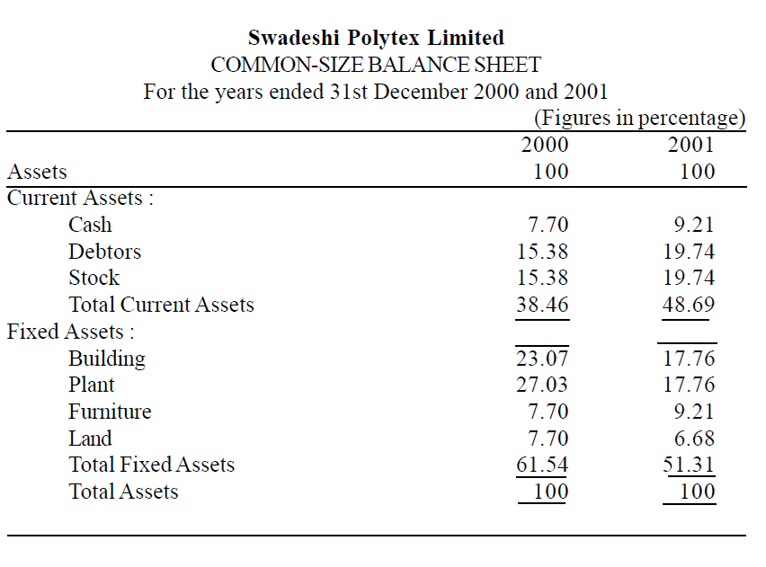

Slide 23


Slide 24
3. Trend Analysis
Trend analysis is a financial statement analysis technique that shows changes in the amounts of corresponding financial statement items over a period of time. It is a useful tool to evaluate the trend situations
Also known as Horizontal Analysis

Slide 25
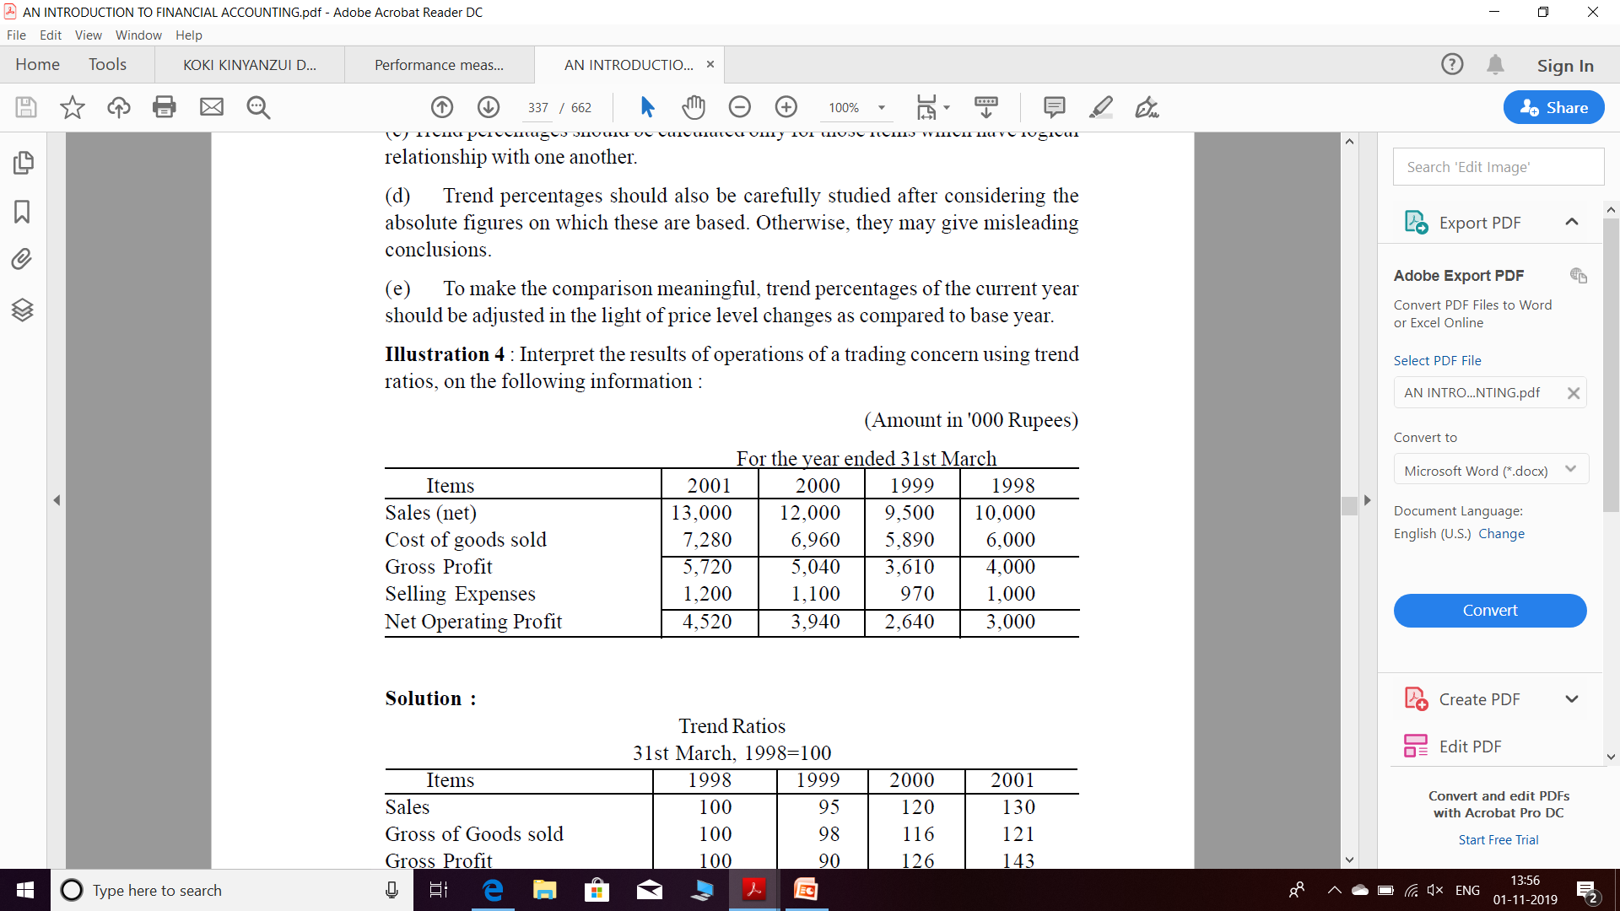

Slide 26


Slide 27
4. Cash Flow Statement
A cash flow statement is a financial statement that shows how changes in balance sheet accounts and income affect cash and cash equivalents, and breaks the analysis down to operating, investing, and financing activities.

Slide 28
5. Fund flow statement:
Funds Flow Statement is a statement prepared to analyse the reasons for changes in the Financial Position of a Company between 2 Balance Sheets.
It shows the inflow and outflow of funds i.e. Sources and Applications of funds for a particular period.

Slide 29
6. Ratio Analysis
Ratio Analysis is the quantitative relation between two amounts showing the number of times one value contains or is contained within the other.
Ratio analysis is a quantitative method of gaining insight into a company's liquidity, operational efficiency, and profitability by comparing information contained in its financial statements

Slide 30
THANK YOU

